Slide 1







BUILDING AND SECURING A SMALL NETWORK
Supervisor: Eng. Khaled Abd Rabo
01

Slide 2




TEAM MEMBERS
Saleh Adel Saleh
Nadeem Hamdy Mohamed
Mohamed Mabrouk Mohamed
Karim Hossam El-Deghidy
Omar Khalid El-Sayed
Omar Sherif Mahmoud
02

Slide 3

MISSION CONTENT
Network Design
01
Devices Configuration
02
Security Implementation and Testing
03
02

Slide 4
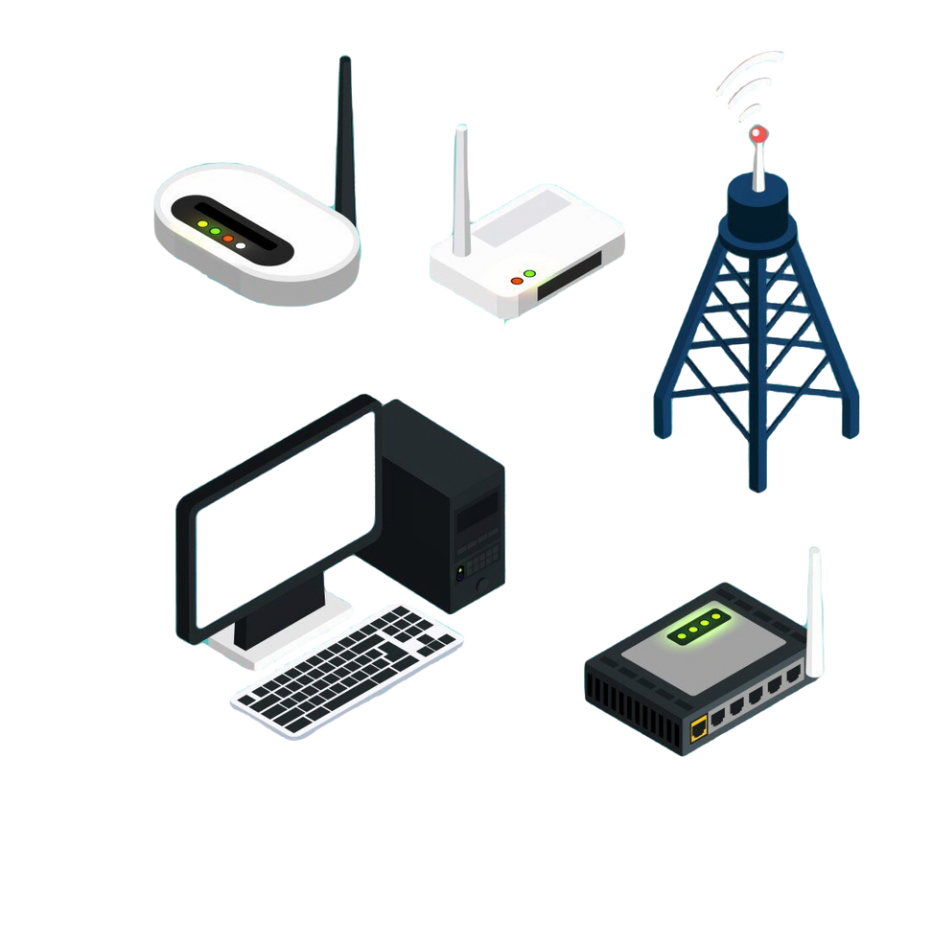
NETWORK DESIGN
Design the Physical Layout
01
Router: Connect different network segments/VLANs.
Switches: Connected with multiple devices within different segments/VLANs.
A web server: a sever that hosts and delivers web traffic to users over the internet handling requests via protocols like HTTP/HTTPS.
A database server: a server that provides database services to other computers or applications, enabling the storage, retrieval, and management of data.
03

Slide 5
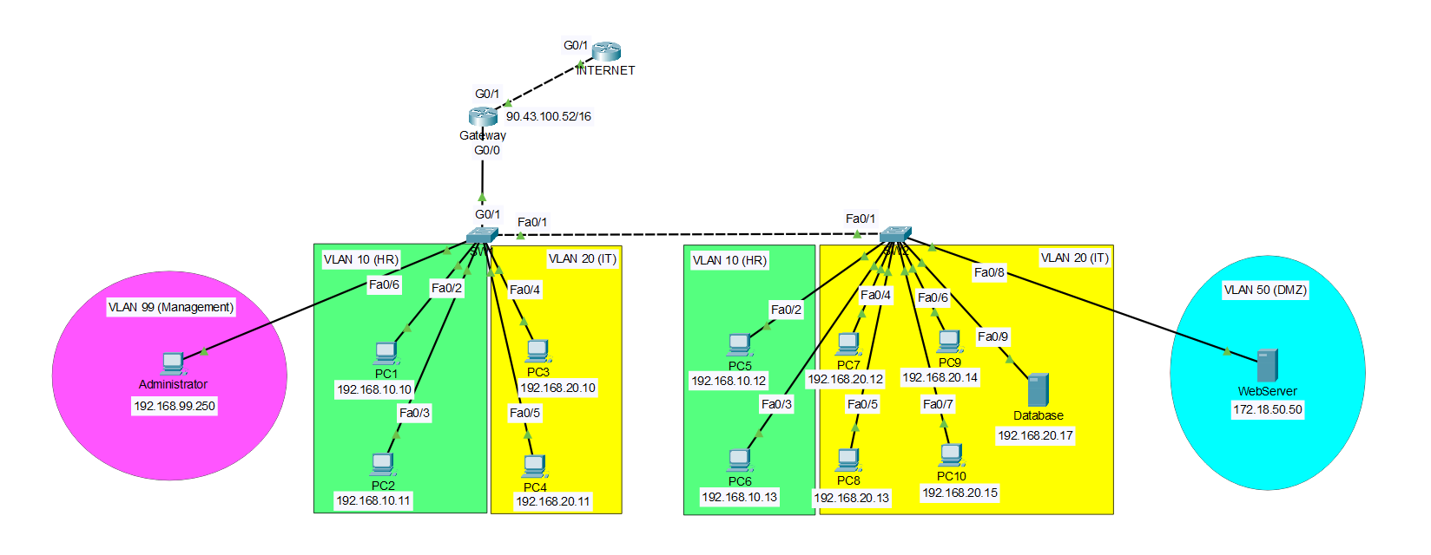
The main network consists of one router and 2 switches, Switch 1 contains 2 end devices in VLAN 10, 2 end devices in VLAN 20, and connects the administrator’s device in vlan 99, As for switch 2, it contains 2 end devices in VLAN 10, 4 end devices and a database server in VLAN 20, and web server in VLAN 50.
04

Slide 6

Network Segments
We have four main VLANs which are:
VLAN 10 (HR): For HR department devices.
VLAN 20 (IT): For IT department devices.
VLAN 50 (DMZ): Contains the web server and is accessible by every on the internet.
VLAN 99 (Management): For managing the network device via SSH remote connection protocol.
VLAN 100 (Native): Changed the native VLAN to be VLAN 100 instead of the default VLAN 1.
05

Slide 7

Phase - 1 (Initial Configuration)
Configuring Basic Devices Settings
Naming devices
Securing privileged access
Securing console line
Securing VTY lines
Encrypting passwords
Setting a banner
Setting the time and date
06

Slide 8
Configuring SSH For Remote Management
1.Configuring a domain name for the device
2.Generating RSA keys and choosing the modulo
bit size to be 2048
3.Creating an SSH user with username and
password
07

Slide 9
Configuring SSH For Remote Management
4.Allowing VTY logins for two minutes if three failed login attempts occur within 60 seconds.
5.Using SSH version 2
08

Slide 10

Phase - 2 (Implementing VLANs)
Creating VLAN on the switches
Configuring access ports on the switches
Configuring SVIs
Configuring trunk ports on the switches
Configuring router-on-a-stick inter-VLAN routing on the router
Enabling the Physical Interface
09

Slide 11

Phase - 3 (Security Measures)
Implementing Port Security
1. Shutting Down Unused Ports.
2. Mitigating MAC Address Table Overflow Attacks
Enabling Port Security
10

Slide 12
2. Mitigating MAC Address Table Overflow Attacks (continue)
Setting the max. number of secure MAC address to 1
Configuring the learning process for the MAC address to sticky
Setting the Port Security Violation Mode to restrict
11

Slide 13


SECURITY MEASURES
1.Access control:
Inbound and Outbound Rules: Define rules to control traffic based on IP addresses, ports, and protocols.
Access Control Lists (ACLs): Restrict access to sensitive segments.
2.Network Segmentation:
VLANs: Use VLANs to separate different network segments.
Inter-VLAN Routing: Control traffic between VLANs using router-on-a-stick method.
12

Slide 14
3.Implemented features that considers security
Using enable secret instead of enable password for more secure password by using md5 hashing algorithm.
Changing the default native & management VLANs from VLAN 1 to be VLAN 99 (Management) and VLAN 100 (Native).
Using SSH version 2 instead of the legacy version 1.
13

Slide 15
3.Implemented features that considers security
Using a large modulus space with a 2048 bits when generating the RSA keys for SSH communication encryption.
Setting a password policy that restricts using a password length of min. size of 12 characters when configuring the network devices.
Allowing VTY logins for two minutes if three failed login attempts occur within 60 seconds.
14

Slide 16
SECURITY MEASURES
03
4.Mitigating VLAN Hopping Attacks
Disable DTP (auto trunking) negotiations on non-trunking ports by using the switchport mode access interface configuration command.
Disable unused ports and put them in an unused VLAN.
Manually enable the trunk link on a trunking port by using the switchport mode trunk command.
Disable DTP (auto trunking) negotiations on trunking ports by using the switchport nonegotiate command.
Set the native VLAN to a VLAN other than VLAN 1 by using the switchport trunk native vlan vlan_number command.
15

Slide 17




Best Practices for Network Security
Strong Password Policies: Encourage the use of complex, unique passwords.
Regular Software Updates: Ensure that all software, firmware, and devices are up-to-date.
Network Monitoring: Continuous monitoring of traffic to detect unusual activities.
Backup and Recovery Plan: Regularly backup critical data and have a disaster recovery strategy.
16

Slide 18
THANK
YOU
17

